Slide 1
CYBER SECURITY UPSKILLING PROGRAM قدم خلال مبادرة زنك/2 في جامعة البلقاء التطبيقية بالتعاون مع أكاديمية سايبر شيلد AUG 2024 Networks Part Version 1
INST.:ENG.ALI BANI BAKAR-0778642376(CYBER SHIELD ACADEMY)
DONE BY: ENG. Dana Al-Mahrouk-0798697842-BAU.UNIV.

Slide 2
Outline
Networks
Linux Essentials
Cybersecurity Foundation
Ethical Hacking
Digital Forensic Investigation

Slide 3
Networking
TCP/IP & OSI Model
Network Devices
Host Devices
Tool:
Packet Tracer
Wireshark
GNS3

Slide 4
Day 1
Outline:
TCP/IP Model
Network Devices
Switch
Router
Host Devices
PC
Server
Web Server
DNS Server
Message & Ping
Broadcast & ARP Table
Project at packet tracer

Slide 5
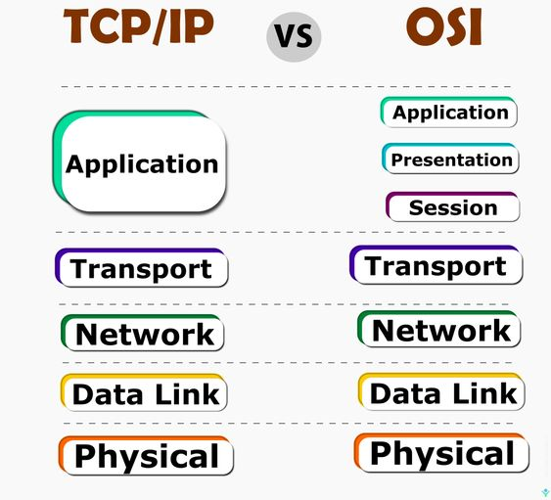
TCP/IP Model
Have 5 Layers
From CISCO
Encapsulation:
Each layer adds its own data [control data] to the [Data].
Data
[Transport Header (Port #) | Data] ➔ Segment
[Network Header (IP) | Port # | Data] ➔ Packet
[Data Link Header (MAC) | IP | Port # | Data] ➔ Frame
Bits

Slide 6
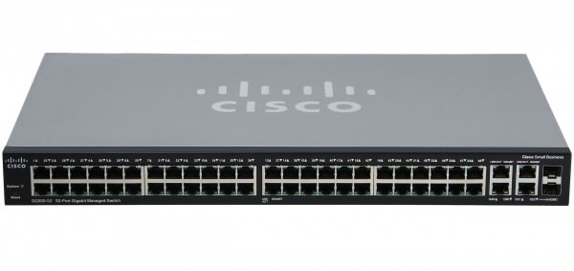

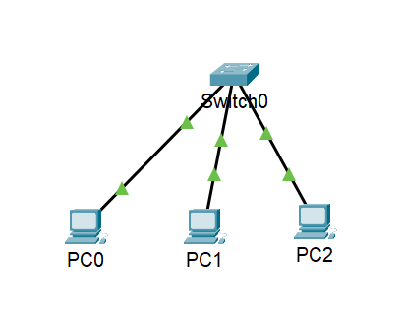
Network Devices
Switch:
Connects between two host devices (End devices), one Network.
Work at layer 2 (Data Link Layer) ➔ MAC Address.
Switch have ports:
Console
Fast Ethernet [0/1 – 0/24 || 0/32]
Gigabit Ethernet [0/1 – 0/2]

Slide 7
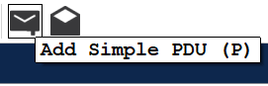
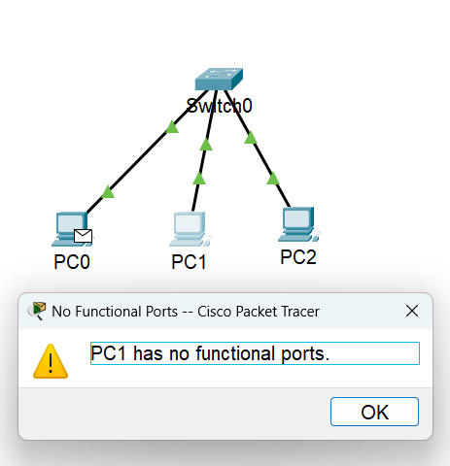
Message
Test connection: (Ping) ➔ ICMP ‘L3 Network ’
Echo request
Echo replay / response
Add message ➔ Error ➔ PC has no functional ports ➔ PC need IP Address
Solution ➔ PC ➔ Desktop ➔ IP Configuration :
IPv4 Address: 192.168.0.2 ~ 192.168.0.4
Subnet Mask: 255.255.255.0 ➔ Default no change
Q: Switch works at layer 2 (Data link), it can see the MAC Address only (can not see the IP Address), ‘MAC Address is a unique number comes with the device when you bought it’, the question is: Why does the connection succussed only when we put IP Address –layer 3 (Network)- to PC?

Slide 8


Broadcast message
ARP L2
F0/1
F0/3
F0/2
A) Ping <dest / target ip>
B) Broadcast MAC ➔ FF:FF:FF:FF:FF:FF
Switch sends the message to all devices (except sender), to identify the MAC Address of the Destination IP Address that sender needs to know.
Note:
Broadcast IP ➔ 255.255.255.255
1) Send message ➔ ping
2)
Request:
[src MAC | dest MAC | src IP | dest IP | Data]
[ 02 | ?? | .0.2 | .0.3 | Data]
Sender does not know the MAC Address for Destination
Q: How can switch solve that?
A: By using Broadcast
Note:
Switch has a Table that contains MAC | Port #
➔ called MAC Table, Switch Table
C) Only the PC that has that dest IP will receive a message (that contain the IP Address for that PC) ➔ Uni-cast
Note:
Sender will save the IP MAC Address for that Receiver at ARP Table
arp -a
MAC | Port #
02 | FE 0/1
03 | FE 0/2
04 | FE 0/3
Replay:
[src MAC | dest MAC | src IP | dest IP | Data]
[ 03 | 02 | .0.3 | .0.2 | Data]

Slide 9
Ping message
ICMP L3
Echo Request
Echo Reply
C
C) The message reaches the destination successfully; The receiver sends a replay message to the sender to confirm that the message has arrived successfully.
- The computer can deal with all network layers, so the computer receiving the message can open the message and read the data.
- If there is no computer with the IP address to which the sender wanted to send the message, it will be returned Request Time Out from switch.
sender
receiver
A) The sender sends the message to the switch, after searching for the MAC address and extracting it from the ARP Table for PC0.
D
A
IP | MAC
.0.2 | 03
.0.3 | 04
D & E) The switch sends this message to the sender, and it reaches the computer successfully
Q: ICMP use TCP or UDP protocol?
Not one of them. ICMP is a protocol in L3, the network layer, and TCP and UDP are in L4, the transport layer. Protocols in a specific layer use protocols in the layer below them.
B) The switch works on the L2, Data Link Layer, which depends on the MAC address of the sender and receiver.
The switch cannot see the layers above the second layer, so if the sender does not have the recipient's MAC address, the switch sends a Broadcast message.
B
E

Slide 10

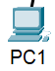
Message Transport
Sender PC
Receiver PC
MAC Address
Ping ICMP
IP Address
IP Address
MAC Address
MAC Address

Slide 11


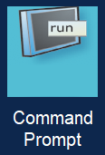
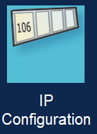
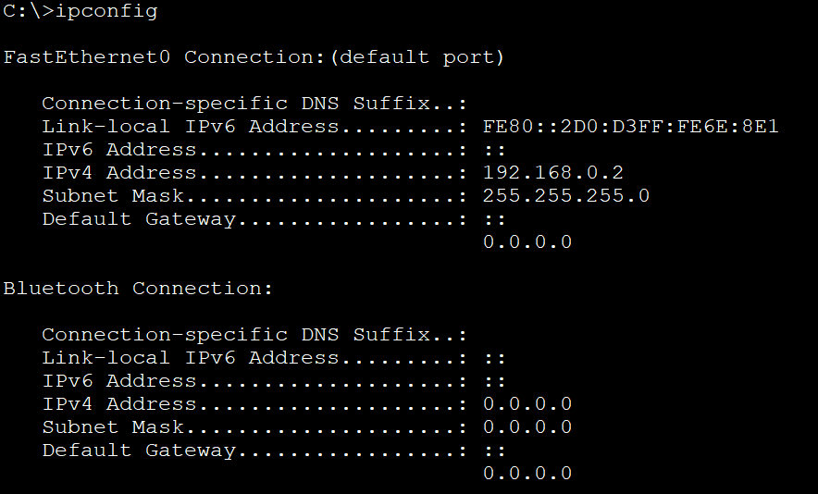
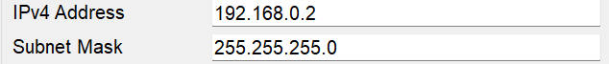
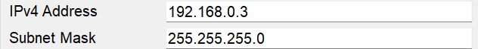
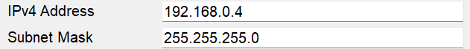

Slide 12
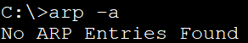
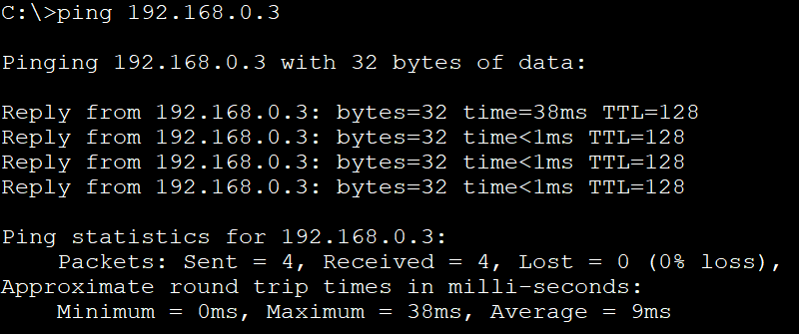
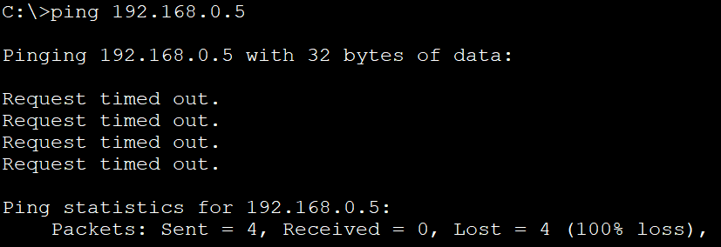
*] At the beginning, there is no ARP Table, however, when PC ping starts to send messages to other PCs at first time ➔ Broadcast sends to all PCs ➔ Target PC receives it own MAC Address ➔ Now, the sender PC get the MAC Address to Distance PC ➔ it saves it at ARP Table & after that it sends message.
**] If target PC found ➔ message [Broadcast message] + 4 echo request – replay ➔ (4 * 2) + 2 = 10
If not found ➔ Request Time out ➔ [Broadcast message] ➔ 2
Note:
ARP scanner ➔ fast and danger [Python]

Slide 13
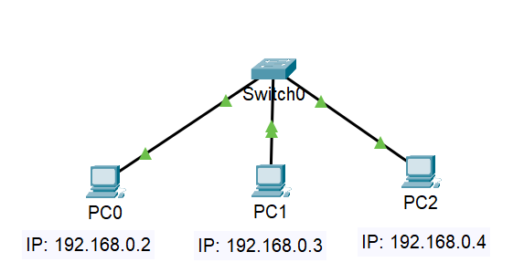
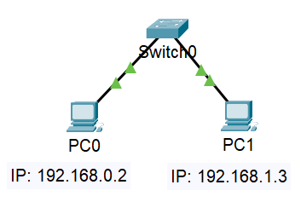
[192.168.0.2 192.168.0.3 192.168.0.4] [192.168.1.2]
Same Network 1
Network 2
Consider subnet mask: 255.255.255.0
Switch can connect devices that can communicate in one network
Connection success
Connection fail
ping

Slide 14

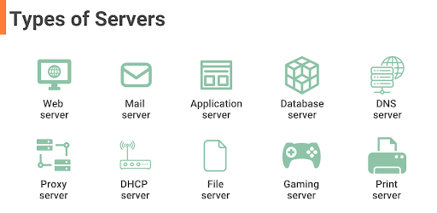
Server
It provides service to users using specific port.
Web Server:
is a computer system capable of delivering web content to end users over the internet or intranet via a web browser
DNS server:
translates domain names into IP addresses, enabling users to access websites using names.

Slide 15
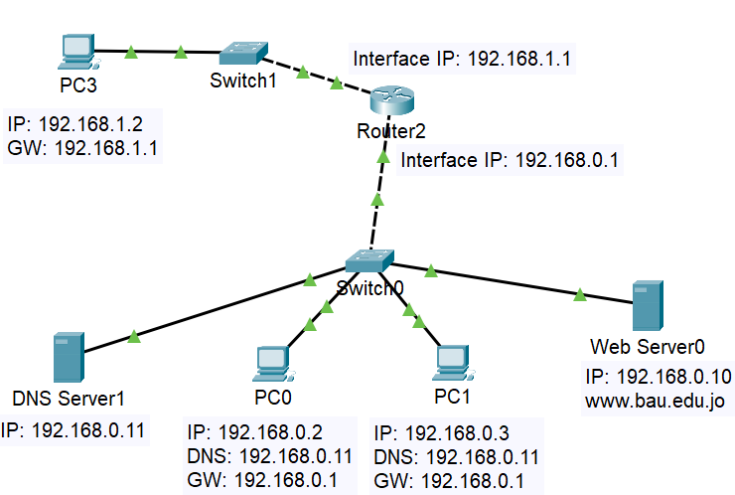
Packet Tracer Typology (CISCO)
Give PCs IP Address.
Give Web Server IP Address
Give Web Server HTTP Service & write simple web page.
PC Connect with Web Server by IP Address
Give DNS Server IP Address & DNS Service, give Web Server a name.
Give PCs DNS Server & connect with Web Server by name

Slide 16
A) Give PCs IP Address

Slide 17
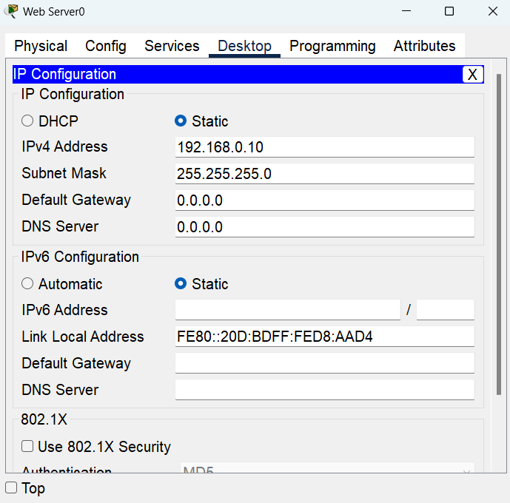
B) Give Web Server IP Address
1
2

Slide 18
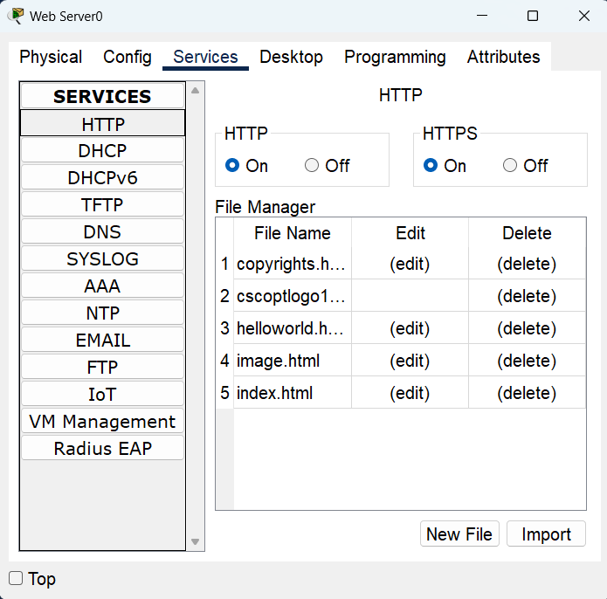
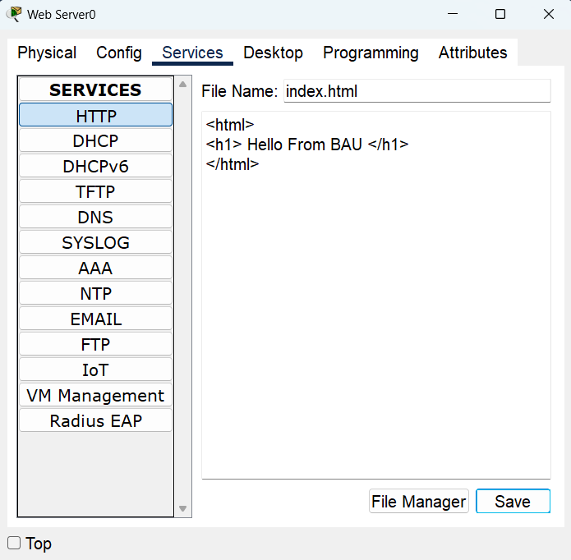
C) Give Web Server HTTP Service & write simple web page.
1
4
2
3
5

Slide 19
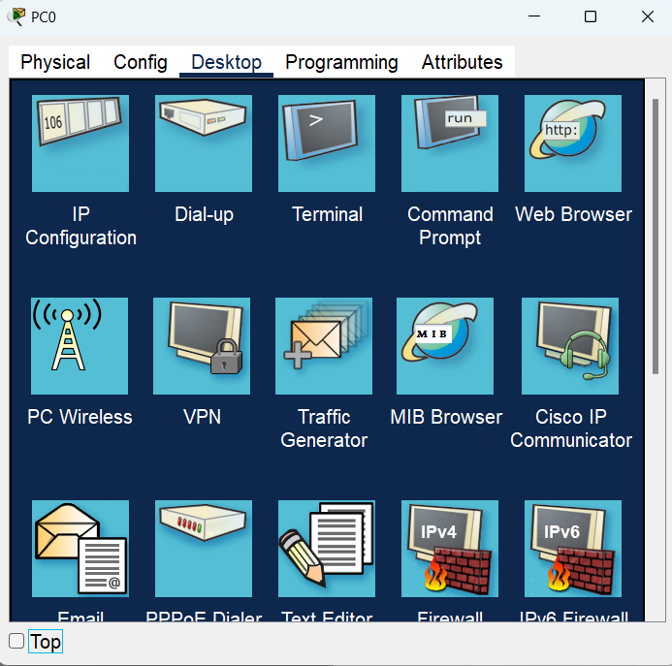
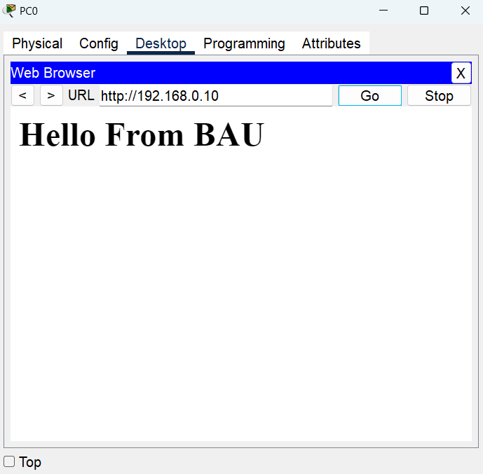
D) PC Connect with Web Server by IP Address
1
2
3
4

Slide 20
Q: how to connect to a web page using DNS?
A: Using DNS Server that convert name to IP Address of Web Server.

Slide 21
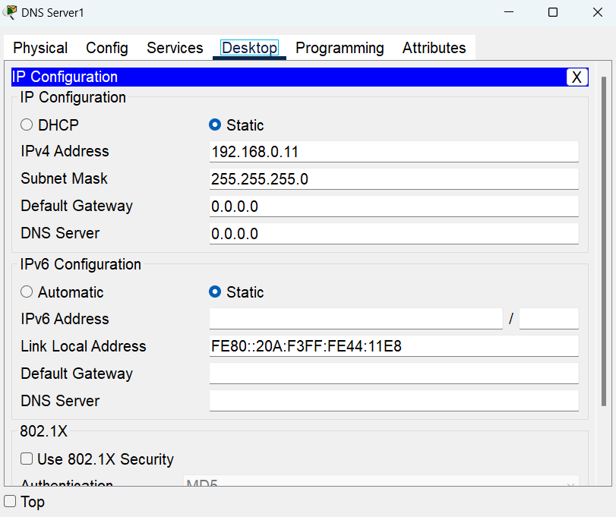
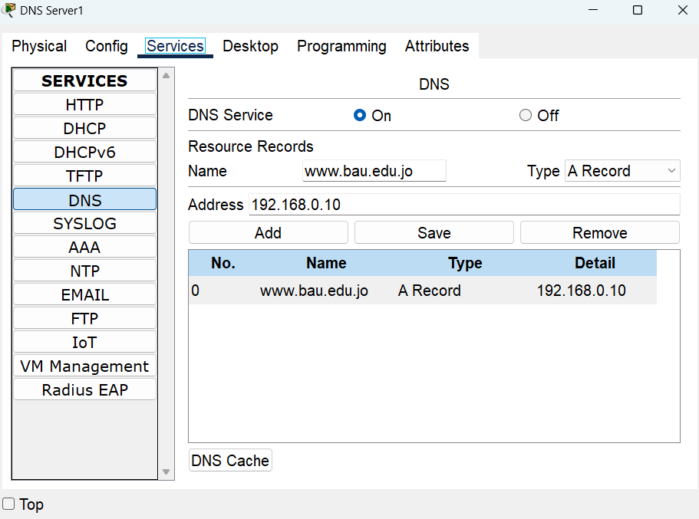
E) Give DNS Server IP Address & DNS Service, give Web Server a name.

Slide 22
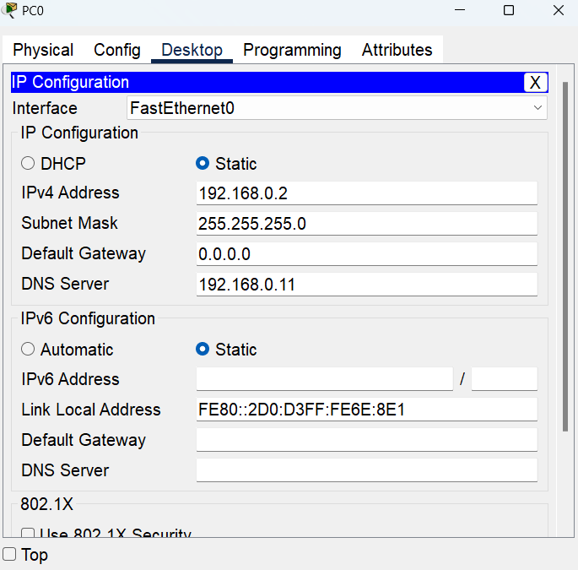
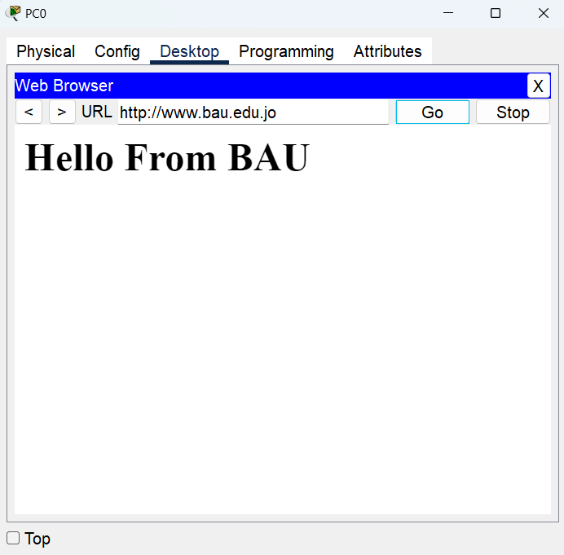
F) Give PCs DNS Server & connect with Web Server by name

Slide 23
How It Work now?

Slide 24



1
3
IP Address
Name
2
4
Name
IP Address
Search in DNS Table
-------------------------
Name | IP Address

Slide 25



5
7
6
8

Slide 26

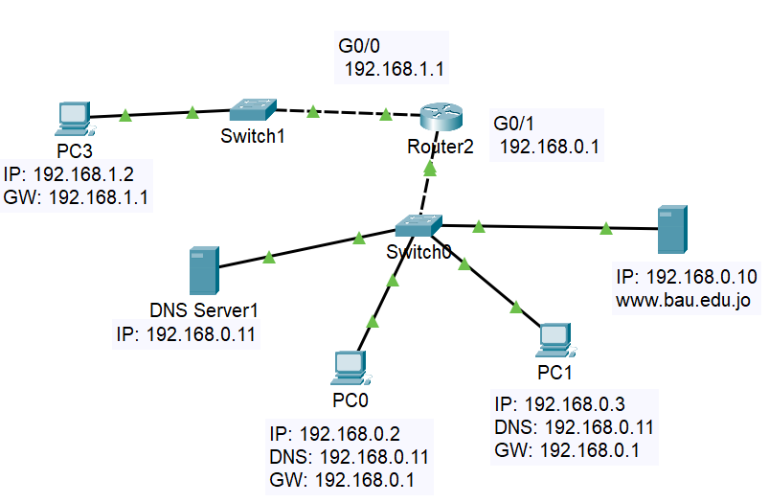
Router
Connects between two network.
PC connects to other PC on different network using Router and put Default Gateway to IP Address of the Router Interface IP that connected to switch to that network.

Slide 27
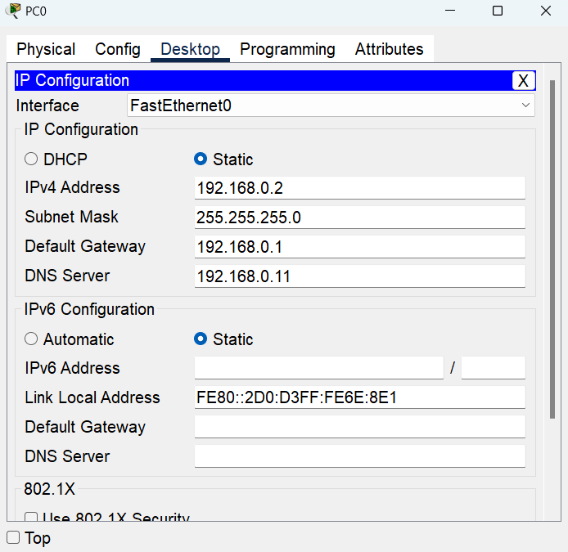
Give PC Default Gateway

Slide 28
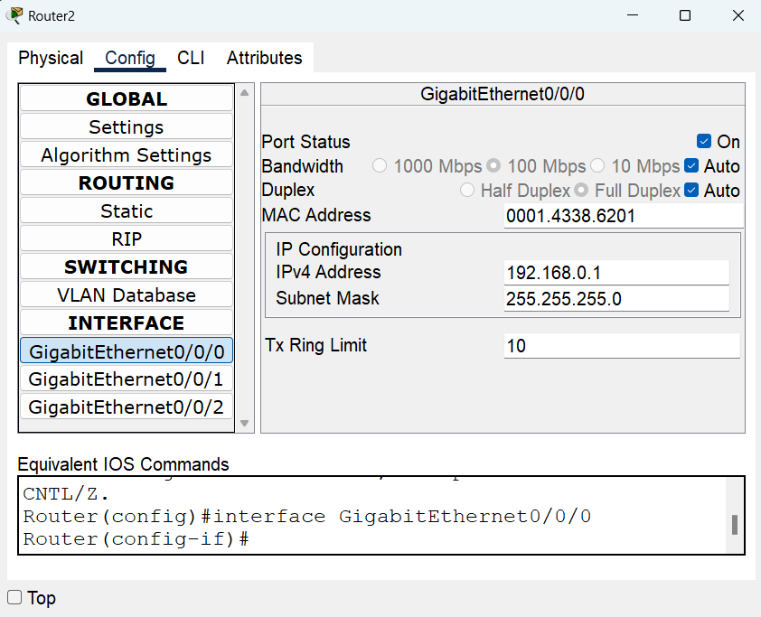
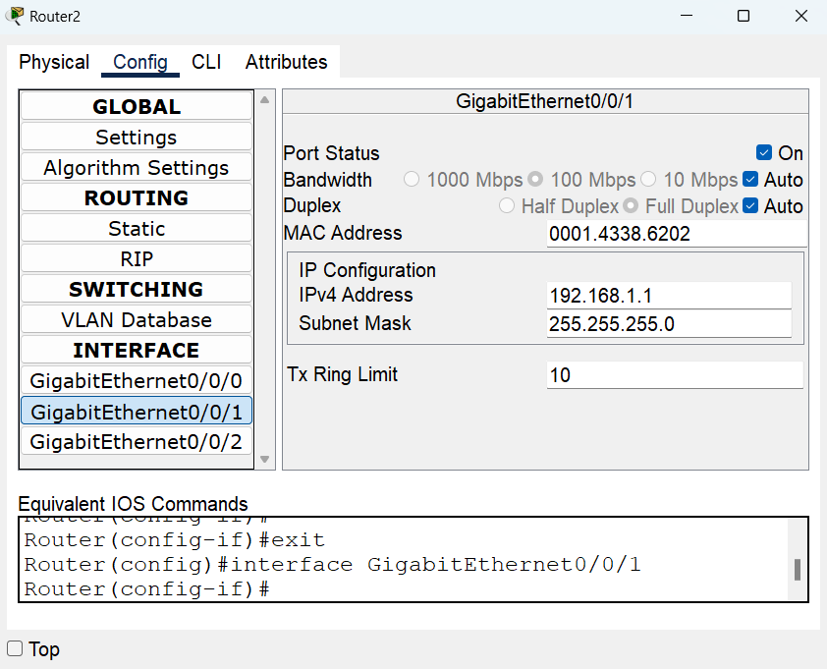
Give Router IPs Address

Slide 29
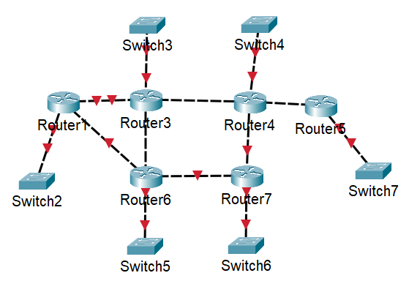
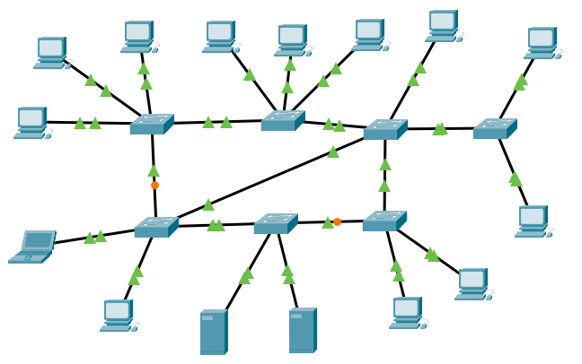
Question
Q1: How many Networks in the typology?
A: 13
Q2: Can a PC or server can be configured to act as a default gateway in a network
A: Yes, as firewall
Q3 : How many Networks?
Ans: 1

Slide 30
Day 2
Outline:
IPv4
Subnetting and CIDR
Network ID & Broadcast IP Examples
DHCP :APIPA & DHCP Server
How does DHCP work?
GNS3
Wireshark
Exercises

Slide 31
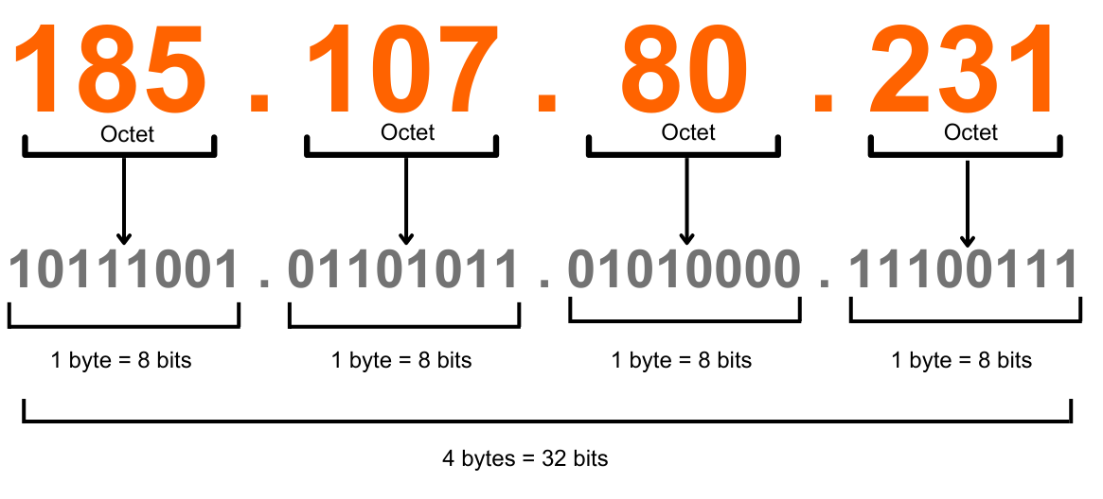
IPv4
MAC Address ➔ do not care about it, it changes during message sending – transform at each router.
IPv4:
4 digit ➔ each 8-bit 1-byte Octet
4 * 8-bit = 32-bit ➔ 2^32 = 4 billions IP Address
8-bit each ➔ 2^8 = 256 ➔ [0 - 255]
_____ . _____ . _____ . _____
IPv6:
8 digit ➔ each 16 bit | 4 hexadicemal ➔ 128 bit
ffff:ffff:ffff:ffff:ffff:ffff:ffff:fffff
Q: why IPv4 still use? (the answer will be discussed later)
0-255
0-255
0-255
0-255

Slide 32
Network ID
IP Address: 192.168.0.2 ➔ 11000000.10101000.00000000.00000010
Subnet Mask: 255.255.255.0 ➔ 11111111.11111111.11111111.00000000
Network ID: [IP AND Subnet Mask] ➔ 192.168.0.0

Slide 33
Ex1:
IP Address: 192.168.0.3 ➔ 11000000.10101000.00000000.00000011
Subnet Mask: 255.255.255.0 ➔ 11111111.11111111.11111111.00000000
Network ID: [IP AND Subnet Mask] ➔ 192.168.0.0
Broadcast IP (Directed): convert host part on IP address to 1’s ➔ last 8-bit ➔ 192.168.0.255
First Host: Network ID + 1 ➔ 192.168.0.1
Last Host: Broadcast IP – 1 ➔ 192.168.0.254

Slide 34
Ex2:
IP Address: 192.168.3.5/24 ➔ 11000000.10101000.00000011.00000101
Subnet Mask: 255.255.255.0 ➔ 11111111.11111111.11111111.00000000
Network ID: [IP AND Subnet Mask] ➔ 192.168.3.0
Broadcast IP (Directed): convert host part on IP address to 1’s ➔ last 8-bit ➔ 192.168.3.255
First Host: Network ID + 1 ➔ 192.168.3.1
Last Host: Broadcast IP – 1 ➔ 192.168.3.254

Slide 35
Ex3:
IP Address: 192.168.4.129/25 ➔ 11000000.10101000.00000010.10000001
Subnet Mask: 255.255.255.128 ➔ 11111111.11111111.11111111.10000000
Network ID: [IP AND Subnet Mask] ➔ 192.168.4.128
Broadcast IP (Directed): convert host part on IP address to 1’s ➔ last 8-bit ➔ 192.168.4.255
First Host: Network ID + 1 ➔ 192.168.4.129
Last Host: Broadcast IP – 1 ➔ 192.168.4.254

Slide 36
Ex4:
IP Address: 192.168.4.64/26 ➔ 11000000.10101000.00000010.01000000
Subnet Mask: 255.255.255.192 ➔ 11111111.11111111.11111111.11000000
Network ID: [IP AND Subnet Mask] ➔ 192.168.4.64
Broadcast IP (Directed): convert host part on IP address to 1’s ➔ last 8-bit ➔ 192.168.4.127
First Host: Network ID + 1 ➔ 192.168.4.65
Last Host: Broadcast IP – 1 ➔ 192.168.4.126

Slide 37
HW:
IP Address: 192.168.5.33/27 ➔ 11000000.10101000.00000101.00100001
Subnet Mask: 255.255.255.224 ➔ 11111111.11111111.11111111.11100000
Network ID: [IP AND Subnet Mask] ➔ 192.168.5.32
Broadcast IP (Directed): convert host part on IP address to 1’s ➔ last 8-bit ➔192.168.5.63
First Host: Network ID + 1 ➔ 192.168.5.31
Last Host: Broadcast IP – 1 ➔ 192.168.5.62

Slide 38
Ex5:
IP Address: 192.168.10.2/25 ➔ 11000000.10101000.00001010.10000010
Subnet Mask: 255.255.255.128 ➔ 11111111.11111111.11111111.10000000
Network ID: [IP AND Subnet Mask] ➔ 192.168.10.128
Broadcast IP (Directed): convert host part on IP address to 1’s ➔ last 8-bit ➔ 192.168.10.255
First Host: Network ID + 1 ➔ 192.168.10.129
Last Host: Broadcast IP – 1 ➔ 192.168.10.254

Slide 39
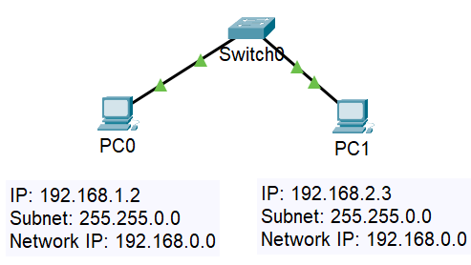
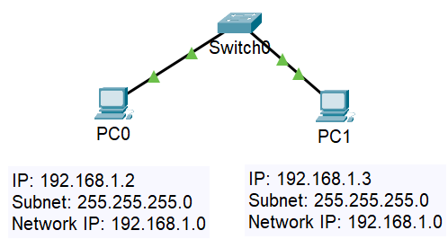
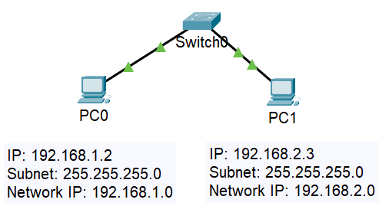
1) Connection Success
3) Connection Success
2) Connection fail
All PCs have the same Network, same Network ID ➔ 192.168.1.0
All PCs have not the same Network, have not same Network ID
Network ID 1 ➔ 192.168.1.0
Network ID 2 ➔ 192.168.2.0
[PC can’t connection]
All PCs have the same Network, same Network ID ➔ 192.168.0.0
Change subnet mask for all PC to ➔ 255.255.0.0

Slide 40
DHCP Protocol
Dynamic Host Configuration Protocol (DHCP): Application Layer 5
provides services that support network applications. It handles the assignment of IP addresses and network configuration to devices, enabling them to communicate on the network.
Give Host (PC) network configuration :
IP Address
Default Gateway
DNS Server
Subnet Mask
Automatic Private IP Addressing (APIPA): when there no DHCP Server, PC give itself a network configuration when we choose DHCP.

Slide 41



DHCP Device?
Switch L2
Router L3
PC L5
Server L5
Client
DHCP Server
Data ➔ DORA
D: Discover
O: Offer
R: Request
A: ACK
Data ➔ DORA
D: Discover
O: Offer
R: Request
A: ACK
DHCP
Port #
Port #
IP Address
IP Address
MAC Address
MAC Address

Slide 42
DHCP Server
It gives you range of hosts.
It Does not give itself an IP like other PC, you must give it a static IP.
You must not allow to give a Server IP from DHCP server ➔ server must have a constant IP ➔ static IP – manually.
You can put a list of exclusive IPs Address; that DHCP will not give it to any hosts.
IP address of hosts is dynamic ➔ it change in some cases:
End connection with a network
Shutdown the host
Lease time ended

Slide 43
How it work?
Discover DHCP server (port# 67) ➔ DORA, to get dynamic host configuration network to PC.
DHCP server is a give a Network Services, at main port at server side not client side.
Discover: The client sends out a DHCP Discover message to find available DHCP servers. This is a broadcast message in local network ➔
IPv4 is Src: 0.0.0.0 & Dest: 255.255.255.255.
MAC is Src: it own MAC & Dest: FF:FF:FF:FF:FF:FF
Q: what is DHCP Relay?
2. Offer: One or more DHCP servers respond with a DHCP Offer message. This message contains an available IP address and other network configuration details.
3. Request: The client responds to the server with a DHCP Request message, indicating that it wants to accept the offered IP address and network configuration.
4. Acknowledgement : The DHCP server sends a DHCP Acknowledge message to confirm that the IP address and network configuration have been assigned to the client. At this point, the client can use the assigned IP address to communicate on the network.

Slide 44
DHCP Server 2
PC
DHCP Server 1
Port 67
Port 68
Port 67
Discover BC
Discover BC
Offer
Offer
Request BC
Request BC
ACK
Time
Time
Time

Slide 45

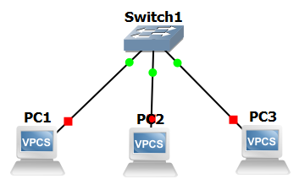


GNS3
GNS3 (Graphical Network Simulator-3)
is a network software emulator that allows users to simulate,
configure, test, and troubleshoot complex networks using virtual devices.

Slide 46

Wireshark
Wireshark is a popular open-source network protocol analyzer used for capturing and analyzing network traffic in real-time. It helps network administrators and security professionals troubleshoot network issues, monitor network performance, and detect security vulnerabilities.

Slide 47
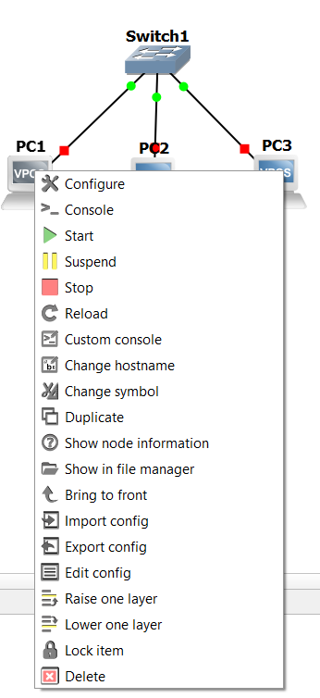
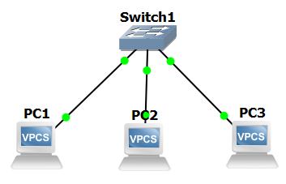
ARP example using GNS3
By default, PC is turn Off
You must turn it On

Slide 48
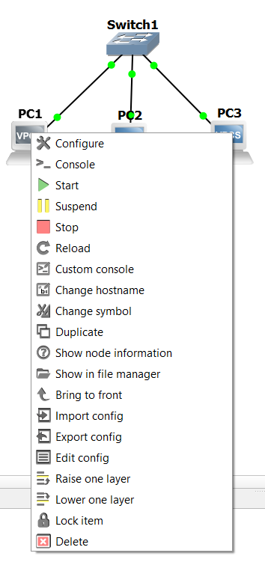
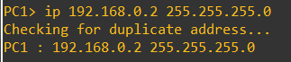
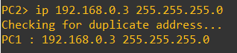
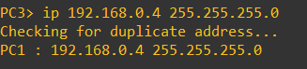
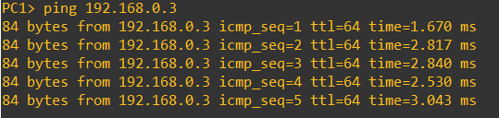
Open Console in PC

Slide 49
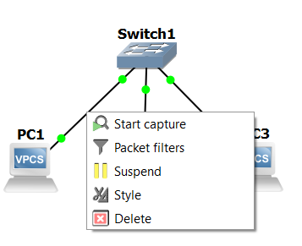
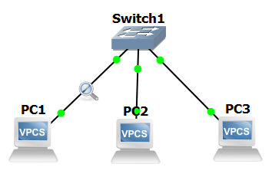
Start Capture PC wire in Wireshark

Slide 50
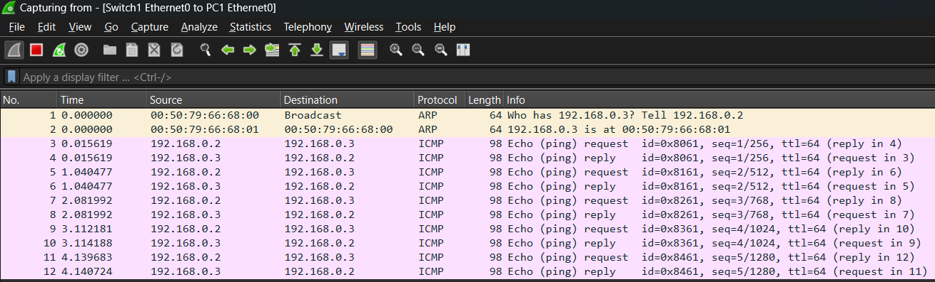
Here we see the capture analysis that we placed on the first computer wire.
First, the device searches for the recipient's MAC address in the ARP table, because for the first time the table is empty, and it will not find the address.
The first message is the ARP message. The device sends a broadcast to all devices asking who owns this IP address, so the receiver sends the MAC address to the sender IP address.
The response is unicast to the sender and contains the recipient MAC address of the message.
The computer saves this address at ARP Table and begins sending the actual message.

Slide 51
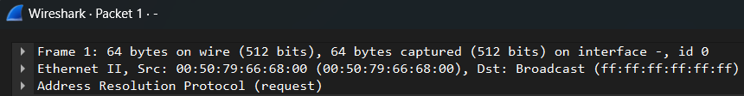

Here is the contents of the first frame sent, the Broadcast frame.
Frame ➔ Physical L1
Ethernet II ➔ Data Link L2
Address Resolution Protocol ➔ message protocol

Slide 52

- Ethernet II: The frame uses the Ethernet II encapsulation.
- Source: `00:50:79:66:68:00` - The MAC address of the source device sending the frame.
- Destination: `ff:ff:ff:ff:ff:ff` - This indicates a broadcast address, meaning the frame is sent to all devices on the local network.
- Type: `ARP (0x0806)` - The frame contains an ARP (Address Resolution Protocol) packet.
- Padding: `000000000000000000000000000000000000000000` - Additional data added to meet the minimum frame size requirement.
- Frame check sequence (FCS): `0x00000000 [unverified]` - The FCS is used to check the integrity of the frame. Here, it shows as unverified, meaning the checksum has not been validated.
- FCS Status: Unverified - Indicates the frame check sequence status has not been verified.

Slide 53


Slide 54



Slide 55


Slide 56


Slide 57
Day 3
Outline:
Transport Layer
Multiplexing
Subnetting

Slide 58
Transport Layer
providing end-to-end communication services for applications. It ensures complete data transfer and manages error correction, data flow, and data segmentation.
Protocols:
TCP
UDP
Key Functions:
Multiplexing and Demultiplexing ➔
Allows multiple applications to use the network simultaneously.
Uses port numbers to direct incoming data
Segmentation and Reassembly ➔ Data divided & reassembled(TCP)
Connection Establishment and Termination ➔ connection/less & handshake
Flow Control ➔ Manages the rate of data transmission (TCP window-based)
Error Detection and Correction ➔ data integrity (TCP ACK & retransmissions)

Slide 59


Port
Client: does not provide a service, he uses a random port that is not reserved for a service.
Server: provides services, uses a port designated for this service and continues listening on it (waiting for the client to request the service from this port)
There are three ranges: ➔ [${(2}^{0}−1)−{(2}^{16}−1)$]
Well-Known Ports: 0 – 1023
Registered Ports: 1024 – 49151
Dynamic and Private Ports: 49152 – 65535 (Client used).
Note:
The port number is determined in the application layer, and is placed in the control data in the transport layer

Slide 60
Question
Q: Why is it ineffective to scan all ports by a hacker on a client?
A:
1) There are many ports and checking them all takes a lot of time.
2) When the client requests a service from the server, the random port is opened for a very limited period and then closed again.

Slide 61

Request
One page
Client Side
Boot Server
24 Hour
www.bau.edu.jo
Data ➔ Request
⬅ Page Response
www.bau.edu.jo
Listening
HTTP
Random
Application Layer
50000
68
67
21
22
80
443
Transport Layer
21
22
443
51000
80
Transport
Layer
Application
Layer
Transport
Layer
Application
Layer
Segment
src port
51000
dest port
80
Data
Request
src port
80
dest port
51000
Data
Page

Slide 62
Request
Multiple pages
Client Side
Server Side
24 Hour
www.bau.edu.jo
www.bau_students.com
Data ➔ Request
www.bau.edu.jo
www.bau_students.com
www.hu.edu.jo
Listening
HTTPS
Listening
HTTP
Application Layer
50000
51000
52000
67
21
22
80
443
Transport Layer
21
22
443
80
Multiplexing
De-Multiplexing
443
www.hu.edu.jo
52000
50000
443
www.bau.edu.jo
51000
www.bau_students.com
80
51000
80
www.bau_students.com
50000
443
www.bau.edu.jo
One Channel
Network Layer
One Channel

Slide 63
Request
Multiple pages
Client Side
Server Side
24 Hour
www.bau.edu.jo
www.bau_students.com
⬅ Page Response
www.bau.edu.jo
www.bau_students.com
www.hu.edu.jo
Listening
HTTPS
Listening
HTTP
Application Layer
50000
51000
52000
67
21
22
80
443
Transport Layer
21
22
443
80
De-Multiplexing
Multiplexing
443
50000
www.bau.edu.jo
80
www.bau_students.com
51000
80
www.bau_students.com
51000
443
50000
www.bau.edu.jo
www.hu.edu.jo
443
52000
One Channel
Network Layer
One Channel

Slide 64




It takes all instructions and executes them at once.
C Java
Compiler
Instructions are executed line by line.
Gives direct output per line
CLI Linux MATLAB Python
Interpreter
Assembly
Assembler

Slide 65
Basic configuration for Router using CLI
Router Models
enable
configuration terminal
User Model >
Privilege Model #
Configuration Model (config)#
disenable
interface
gigabitEthernet0/0
Interface level
(config-if)#
interface
fastEthernet0/0
show command
Routing engine level
(config-route)#
route rip | ospf…
Line level
(config-line)#
line console | vty | tty
Line level
(dhcp-config)#
ip dhcp pool <name>

Slide 66


Route Command
Router>enable
Router#configure terminal
Enter configuration commands, one per line. End with CNTL/Z.
Router(config)#interface gigabitEthernet0/0
Router(config-if)#ip address 192.168.0.1 255.255.255.0
Router(config-if)#no shutdown
Router(config-if)#exit
Router(config)#interface gigabitEthernet0/1
Router(config-if)#ip address 192.168.1.1 255.255.255.0
Router(config-if)#no shutdown
Router(config-if)#do write

Slide 67
PC in CLI
ipconfig <ip address> <subnet mask> <default gateway>
PC0:
C:\>ipconfig 192.168.0.2 255.255.255.0 192.168.0.1
PC1:
C:\>ipconfig 192.168.1.2 255.255.255.0 192.168.1.1
Ping:
PC0:
ping 192.168.1.2

Slide 68

DHCP Router
Q: DHCP operates at the Application Layer (Layer 7), and routers are network devices that primarily function at the Network Layer (Layer 3). How can a router also serve as a DHCP server, which is typically a Layer 7 function?
A: Integrated Services: Modern routers often come with integrated software that includes DHCP server functionality. This allows them to manage IP address allocation and network configuration for devices on the network.
DHCP Router
Same Network
Client

Slide 69

C
B
A

Slide 70
R1 DHCP Router
R2 Client
R1#configure terminal
R1(config)#interface fastEthernet0/0
R1(config-if)#ip address 192.168.0.1 255.255.255.0
R1(config-if)#no shutdown
R1(config-if)#exit
R1#configure terminal
R1(config)#ip dhcp pool legal
R1(dhcp-config)#network 192.168.0.0 255.255.255.0
R1(dhcp-config)#dns-server 1.1.1.1
R1(dhcp-config)#do write
Building configuration...
[OK]
R2#configure terminal
Enter configuration commands, one per line. End with CNTL/Z.
R2(config)#interface fastEthernet0/0
R2(config-if)#ip address dhcp
R2(config-if)#no shutdown
R2(config-if)#exit
R5#show ip interface
FastEthernet0/0 is up, line protocol is up
Internet address is 192.168.0.2/24
Broadcast address is 255.255.255.255
Address determined by DHCP

Slide 71

Adding Hacker DHCP Router ➔ who will win?
R3#configure terminal
R3(config)#interface fastEthernet0/0
R3(config-if)#ip address 172.16.0.1 255.255.255.0
R3(config-if)#no shutdown
R3(config-if)#exit
R3#configure terminal
R3(config)#ip dhcp pool legal
R3(dhcp-config)#network 172.16.0.0 255.255.255.0
R3(dhcp-config)#dns-server 1.1.1.1
R3(dhcp-config)#do write
Building configuration...
[OK]

Slide 72

How win? Legal or Hacker

Slide 73

Random
Hacker
win
Lega
win
Hacker
win

Slide 74


How can Hacker win?
Winning and losing in this is random.
How can a hacker make his win rate higher than a legitimate router?
The hacker can use some network tactics to increase his chance of winning. For example, he can make the legitimate router busy in other work, such as the hacker sending a DDoS attack on the router.
DDoS
Attack

Slide 75
SubNetting
Q: Why we need to use subnetting?
Subnetting allows for the creation of multiple subnets, enhancing network organization, management, and security.
Easy to use and manage.

Slide 76
Ex1:
IP: 192.168.0.4/24
Subnet mask: 255.255.255.0
3 Labs
Subnet mask: 255.255.255.11000000
3 labs ➔ 2 Bit needs
IP1: 192.168.0.00000000/26
IP1: 192.168.0.0/26
Subnet mask: 255.255.255.11000000
Network ID: 192.168.0.00000000 ➔ 0
Broadcast: 192.168.0.00111111 ➔ 63
IP3: 192.168.0.10000000/26
IP3: 192.168.0.128/26
Subnet mask: 255.255.255.11000000
Network ID:192.168.0.10000000 ➔ 128
Broadcast: 192.168.0.10111111 ➔ 191
IP2: 192.168.0.01000000/26
IP2: 192.168.0.64/26
Subnet mask: 255.255.255.11000000
Network ID: 192.168.0.01000000 ➔ 64
Broadcast: 192.168.0.01111111 ➔ 127
IP4: 192.168.0.11000000/26
IP4: 192.168.0.192/26
Subnet mask: 255.255.255.11000000
Network ID:192.168.0.11000000 ➔ 192
Broadcast: 192.168.0.11111111 ➔ 225

Slide 77
Ex2:
IP: 192.168.5.0/24
Subnet mask: 255.255.255.0
2 Labs
Subnet mask: 255.255.255.10000000
2 labs ➔ 1 Bit need
IP1: 192.168.5.00000000/25
IP1: 192.168.5.0/25
Subnet mask: 255.255.255.10000000
Network ID: 192.168.5.00000000 ➔ 0
Broadcast: 192.168.5.01111111 ➔ 127
IP2: 192.168.5.10000000/25
IP2: 192.168.5.128/25
Subnet mask: 255.255.255.10000000
Network ID:192.168.5.10000000 ➔ 128
Broadcast: 192.168.5.11111111 ➔ 255

Slide 78
Ex3:
IP: 192.168.5.0/24
Subnet mask: 255.255.255.0 ➔ 255.255.255.11100000
7 Labs ➔ 3 bits
IP1: 192.168.5.00000000/27
IP1: 192.168.5.0/27
Subnet mask: 255.255.255.11100000
Network ID: 192.168.5.00000000 ➔ 0
Broadcast: 192.168.5.00011111 ➔ 31
IP4: 192.168.5.01100000/27
IP4: 192.168.5.96/27
Subnet mask: 255.255.255.11100000
Network ID: 192.168.5.011000000 ➔ 96
Broadcast: 192.168.5.01111111 ➔ 127
IP6: 192.168.5.10100000/27
IP6: 192.168.5.160/27
Subnet mask: 255.255.255.11100000
Network ID: 192.168.5.10100000 ➔ 160
Broadcast: 192.168.5.10111111 ➔ 191
IP2: 192.168.5.00100000/27
IP2: 192.168.5.32/27
Subnet mask: 255.255.255.11100000
Network ID: 192.168.5.00100000 ➔ 32
Broadcast: 192.168.5.00111111 ➔ 63
IP5: 192.168.5.10000000/27
IP5: 192.168.5.128/27
Subnet mask: 255.255.255.11100000
Network ID: 192.168.5.10000000 ➔ 128
Broadcast: 192.168.5.10011111 ➔ 159
IP7: 192.168.5.11000000/27
IP7: 192.168.5.192/27
Subnet mask: 255.255.255.11100000
Network ID: 192.168.5.11000000 ➔ 192
Broadcast: 192.168.5.11011111 ➔ 223
IP3: 192.168.5.01000000/27
IP3: 192.168.5.64/27
Subnet mask: 255.255.255.11100000
Network ID: 192.168.5.01000000 ➔ 64
Broadcast: 192.168.5.01011111 ➔ 95
IP8: 192.168.5.11100000/27
IP8: 192.168.5.224/27
Subnet mask: 255.255.255.11100000
Network ID: 192.168.5.11100000 ➔ 224
Broadcast: 192.168.5.11111111 ➔ 255

Slide 79
Day 4
Outline
Transport Layer Function
Segmentation
Flow Control
Congestion Control
Error Detection
Transport Layer Protocol
TCP
UDP
TCP Session

Slide 80
Day 4
Outline Continue…
Router Password
Enable Password
Enable Secret
Console Password
vty Password
Telnet in GNS3 & Wireshark
Public & Private IP
Application Protocols
Intro to VLAN

Slide 81
Transport Layer Function
Multiplexing: combine multiple signals into one medium or channel, from multiple ports coming from Application layer to one channel to Network layer.
Application Layer
50000
51000
52000
67
21
22
80
443
Transport Layer
Multiplexing
443
www.hu.edu.jo
52000
50000
51000
www.bau_students.com
80
51000
50000
443
www.bau.edu.jo
One Channel
Network Layer

Slide 82
2. Segmentation (Both)
Dividing data into smaller, more manageable pieces for transmission over a network has several advantages:
Data Integrity: Smaller segments reduce the likelihood of errors.
Error Reduction: Transmitting smaller amounts of data at a time decreases the chances of errors occurring.
Efficient Routing: Each segment can take its own path through the network, depending on traffic conditions.
Reordering by Receiver: The order in which segments are received is not important; the receiver will reorder the segments into the correct sequence, It make at:
TCP ➔ Transport Layer
UDP ➔ Application Layer
Data 5GB
Application Layer
Transport Layer
50000
Segmentation
443
Segment 1
50000
50000
Segment 2
443
50000
443
Segment 3

Slide 83
3. Flow Control (TCP Only)
Without control flow
20Mbps
Sender
20Mbps
Receiver
5Mbps
manage the rate of data transmission between a sender and a receiver, ensuring that the sender does not overwhelm the receiver with too much data at once.
Problem: If the recipient of the message is slow and cannot receive a large amount of data in a short time, and the sender is fast and can handle a large amount of data by sending and receiving, then the receiver loses some data.
Solution: Before the data is sent, the sender and the receiver agree on the speed of sending the data, depending on how much the slower one can tolerate.
If the route allows more data to be sent, it will be done
15Mbps – size of storage ➔ Loss data
With control flow
5Mbps
Sender
20Mbps
Receiver
5Mbps
Zero Loss data

Slide 84
4. Congestion Control (TCP Only)
manage the volume of data being sent into the network to avoid overwhelming it. This involves dynamically by controlling the window size adjusting the rate of data transmission based on current network conditions.

Slide 85
5. Error Detection & Correction
TCP
UDP
Error Detection
If there are error in data, message will be deleted and ask sender to send it again
If there are error in data, message will be deleted only
Send Data
Send Data
Sender
Receiver
Sender
Receiver
Error Correction
Send Data Again
Sender
Receiver

Slide 86

TCP Header
Data Integrity
Flow Control
Error Detection

Slide 87

UDP Header
Error Detection

Slide 88
 | TCP | UDP
Connection
Data Reliable
Header | big | small
Error Detection
Error Correction
Performance

Slide 89
Application Layer Protocol ➔ (TCP | UDP)
 | (TCP | UDP)
FTP (20) | TCP
HTTP (80) & HTTPS (443) | TCP
SMTP (25) & POP3 (110) | TCP
Telnet (23) & SSH (22) | TCP
DNS (53) | Primarily UDP for queries, TCP for zone transfers
DHCP (67 (server), 68 (client)) | UDP
TFTP (69) | UDP
ICMP (??) | ??

Slide 90
Session
Client
BAU Server
Open Session (3-way handshaking) [Hi].
Data Transfer [Data].
Terminate Session (4-way handshaking) [Bye].
TCP/IP ➔ Transport Layer ➔ TCP ➔ Session ➔ Open Session
SYN
1: Open Session
0: else
SEQ (Sequence Number)
ensuring data is delivered in the correct order and assists in detecting missing segments.
ACK (Acknowledgment Number)
used by the receiver to indicate the next byte of data it expects to receive from the sender.
Random Port
Port 443
SYN=1 SEQ=200
SYN=1 SEQ=400 ACK=201
SEQ=201 ACK=401
Open Session
Session opened
Data Transferer

Slide 91

Router Password
Types:
Enable Password, Secret Password
Console Password
Line vty Password
1
2
Console (Physical wire)
Enable password
Console password
enable
configuration terminal
VTY (Remotely ➔ Telnet | SSH)
User Model >
Privilege Model #
Configuration Model (config)#
3
Vty password
disenable
HTTP

Slide 92
1. Enable Password
2. Secret Password
R>enable
R#configure terminal
R(config)#enable password 1234
R(config)#do write
R(config)#exit
R>enable
Password: 1234
R#show run
R>enable
R#configure terminal
R(config)#enable secret abcd
R(config)#do write
R(config)#exit
R>enable
Password: 1234
R#show run
Hash Value ➔ MD5

Slide 93
3. Console Password
4. vty Password
R>enable
R#configure terminal
R(config)#line console 0
R(config-line)#password zinc
R(config-line)#login
R(config-line)#do write
Turn Off Router
Turn On Router
Open Console
Password: zinc
R>
R>enable
R#configure terminal
R(config)#line vty 0 3
R(config-line)#password zinc
R(config-line)#login
R(config-line)#do write
Turn Off Router
Turn On Router
Open using Telnet | SSH

Slide 94

VTY Connection Router using Telnet
R>enable
R#configure terminal
R(config)#interface GigaEthernet0/0
R(config)#ip address 192.168.0.1 255.255.255.0
R(config)#no shutdown
R(config)#do ping 192.168.0.2
R(config)#exit
R(config)#line vty 0 4
R(config-vty)#password zinc
R(config-vty)#login
R(config-vty)#exit
R(config)#enable password 1234
R(config)#do write
C:/>telnet 192.168.0.1
Trying ….. Open
Password: zinc
R>enable
Password: 1234
R#

Slide 95


Secure of VTY Connection in GNS3
R1#conf t
R1(config)#int f0/0
R1(config-if)#ip add 192.168.0.1 255.255.255.0
R1(config-if)#no shutdown
R1(config-if)#exit
R2#conf t
R2(config)#int f0/0
R2(config-if)#ip add 192.168.0.2 255.255.255.0
R2(config-if)#no shutdown
R1(config-if)#exit
IP: 192.168.0.1
SM: 255.255.255.0
F0/0
F0/0
IP: 192.168.0.2
SM: 255.255.255.0

Slide 96
R1#ping 192.168.0.2
Type escape sequence to abort.
Sending 5, 100-byte ICMP Echos to 192.168.0.2, timeout is 2 seconds:
.!!!!
Success rate is 80 percent (4/5), round-trip min/avg/max = 28/57/80 ms
R1#conf t
R1(config)#enable secret 1234
R1(config)#line vty 0 4
R1(config-line)#password zinc
R1(config-line)#login
R1(config-line)#do wr
R2#telnet 192.168.0.1
Trying 192.168.0.1 ... Open
User Access Verification
Password: <zinc>
R1>en
Password: <1234>
R1#

Slide 97

Telnet Capture
Q: What can Hacker see?
Q: How is client and how is server?
Q: Telnet Layer?

Slide 98


Slide 99


Slide 100

Ohhh No… ➔ Hacker See every things

Slide 101

Private & Public IP Address
Q: why IPv4 still used?
Private & Public IP Address technical
Private IP addresses are used within a private network and are not routable on the internet. They are intended for internal use within an organization or home. (Free)
Public IP addresses are assigned by Internet Service Providers (ISPs) and are routable on the internet. They are unique and must be registered with the Internet Assigned Numbers Authority (IANA). (sale $$)

Slide 102

NAT (Network Address Translation)
- Routers use NAT to map private IP addresses to a public IP address, allowing multiple devices on a private network to share a single public IP address when accessing the internet.

Slide 103
Mail Protocols
HW: what difference between SMTP, HTTP, IMAP, and POP3?
HW: FTP use two ports 20 and 21,what are the differences between them?!
HW: what is TFTP Protocol?
HTTP
IMAP
SMTP
POP3
Sender
Mail Server
Listing for 4 Protocol
Receiver

Slide 104
Ans:
1. SMTP (Simple Mail Transfer Protocol):
Used for sending emails, uses port 25, can also use ports 587 or 465 for encrypted transmission.
Facilitates the sending of email messages between servers. It's used by mail servers to relay outgoing mail.
2. HTTP (Hypertext Transfer Protocol):
Used for transferring hypertext documents, uses port 80 standard 443 for HTTPS secure.
Defines how messages are formatted and transmitted, and how web servers and browsers should respond to various commands. It's the foundation of any data exchange on the Web.
SMTP
Sender
Mail Server
HTTP
Mail Server
Receiver

Slide 105
Cont…
3. IMAP (Internet Message Access Protocol):
Used for retrieving and storing email on a mail server, port 143 for standard, port 993 for encrypted.
Allows multiple clients to manage and access the same mailbox, providing the ability to view and organize emails on the server.
4. POP3 (Post Office Protocol version 3):
Used for retrieving email from a mail server, port 110 for standard and 995 for encrypted.
Downloads emails from the server to the client and, typically, deletes them from the server afterward. It's designed for users to download their email and then disconnect from the mail server.
IMAP
Mail Server
Receiver
POP3
Mail Server
Receiver

Slide 106

Subnetting
Problem:
Subnetting & Subnet mask & IP Address in PC Level…
PC know its network.
PC can change its IP Address ➔ sends message to other networks (less secure)
Q: BC message sends to one or different networks?
ARP:
DHCP:
Relay DHCP:

Slide 107

Broadcast Domain
Without VLANs
Same network ➔ End at first router or VLAN.
So VLANs minimize traffic of broadcast.

Slide 108


VLAN (L2 Switch)
VLANs (Virtual Local Area Networks) are used to segment the network into different broadcast domains. This helps improve security and performance by isolating network traffic.
At the switching level in the data link layer, it is configured in the switch device.
Users cannot see or change it, and they do not know which VLAN it is in and how many VLANs are in the topology.
If a user changes his IP address, he will not connect to other VLANs.
By default, all devices connected to the switch are in VLAN 1 (the default VLAN), and they are all in the same VLAN.

Slide 109
Day 5
Outline
Subnetting & VLANs
Broadcast in VLANs
2 VLANs Project
Switch Ports Modes
Access Mode
Trunk
Dynamic:Auto
dynamicDesirable
Intra VLANs
Router sub-interface & .1q protocol
Wires
Project in IntrVLAN
Routing
Static VS Dynamic Routing
Router Simple Project

Slide 110
Switch Show VLANs
Switch>enable
Switch#show vlan brief
VLAN Name Status Ports
---- -------------------------------- --------- -------------------------------
1 default active Fa0/1, Fa0/2, Fa0/3, Fa0/4
Fa0/5, Fa0/6, Fa0/7, Fa0/8
Fa0/9, Fa0/10, Fa0/11, Fa0/12
Fa0/13, Fa0/14, Fa0/15, Fa0/16
Fa0/17, Fa0/18, Fa0/19, Fa0/20
Fa0/21, Fa0/22, Fa0/23, Fa0/24
Gig0/1, Gig0/2
1002 fddi-default active
1003 token-ring-default active
1004 fddinet-default active
1005 trnet-default active

Slide 111

Example 1
All same Network: 192.168.0
.2
.5
.3
.4

Slide 112
Example 1
Switch#configure terminal
Switch(config)#vlan 2
Switch(config-vlan)#exit
Switch(config)#vlan 3
Switch(config-vlan)#exit
Switch(config)#interface fastEthernet0/1
Switch(config-if)#switchport mode access
Switch(config-if)#switchport access vlan 2
Switch(config-if)#do write
Switch(config-if)#exit
Switch(config)#interface fastEthernet0/2
Switch(config-if)#switchport mode access
Switch(config-if)#switchport access vlan 2
Switch(config-if)#do write
Create VLAN 2
Create VLAN 3
Put VLAN 2 in port f0/1 & select mode
Put VLAN 2 in port f0/2 & select mode

Slide 113
Example 1
Switch(config)#interface fastEthernet0/3
Switch(config-if)#switchport mode access
Switch(config-if)#switchport access vlan 3
Switch(config-if)#do write
Switch(config-if)#exit
Switch(config)#interface fastEthernet0/4
Switch(config-if)#switchport mode access
Switch(config-if)#switchport access vlan 3
Switch(config-if)#do write
Put VLAN 3 in port f0/3 & select mode
Put VLAN 3 in port f0/4 & select mode

Slide 114
Switch Show VLANs
Switch#show vlan brief
VLAN Name Status Ports
---- -------------------------------- --------- -------------------------------
1 default active Fa0/5, Fa0/6, Fa0/7, Fa0/8
Fa0/9, Fa0/10, Fa0/11, Fa0/12
Fa0/13, Fa0/14, Fa0/15, Fa0/16
Fa0/17, Fa0/18, Fa0/19, Fa0/20
Fa0/21, Fa0/22, Fa0/23, Fa0/24
Gig0/1, Gig0/2
2 VLAN0002 active Fa0/1, Fa0/2
3 VLAN0003 active Fa0/3, Fa0/4
1002 fddi-default active
1003 token-ring-default active
1004 fddinet-default active
1005 trnet-default active

Slide 115
Connection
Network | VLAN | Connection
Same | Same
Same | Different
Different | Same
Different | Different

Slide 116

Example 2

Slide 117

Switch Port Models
Switch ports can be configured in different modes:
Access Mode:
is a port configuration mode used on switches for connecting end devices such as computers, printers, and servers.
The port is assigned to a single VLAN.
All traffic coming in and out of the port is untagged, meaning that VLAN information is not included in the Ethernet frames.
Devices connected to an access port are unaware of VLANs.
.2
.5
.3
.4

Slide 118

Access Mode Used
NID: 192.168.0
SM: /24
??
v2
v3
v2
v3
v3
v2
v3
v2
.2
.5
.2
.5
.3
.4
.3
.4
v2
v3
v2
v3
v3
v2
v3
v2
??
.2
.5
.2
.5
.3
.4
.3
.4

Slide 119

Problem
v1
v1
v2
v3
v2
v3
v2
v3
??
v2
v3
.2
.3
.2
.3
.4
.5
.4
.5
Sender
Receiver
Sender
Receiver
v1
v1
v2
v3
v2
v3
v2
v3
v2
v3
.2
.3
.4
.5
.2
.3
.4
.5
Sender
Receiver
Sender
Receiver

Slide 120

2. Trunk Mode
is used on switch ports to carry traffic for multiple VLANs used between routers and servers.
can carry traffic from multiple VLANs.
Traffic on a trunk port is tagged with VLAN identifiers (DTP).
A trunk port can have a native VLAN, which is the VLAN for untagged traffic. By default, the native VLAN is VLAN 1.
Q: Native VLAN?
.2
.5
.3
.4

Slide 121
Use Trunk
Trunk
Trunk
VLAN 2
Access
v2
v3
v2
v3
??
v2
v3
v2
v3
.2
.3
.2
.3
.4
.5
.4
.5
Sender
Receiver
Sender
Receiver
v2
v3
v2
v3
v2
v3
Access
v2
v3
??
.2
.3
.4
.5
.2
.3
.4
.5
Sender
Receiver
Sender
Receiver
Message Deleted

Slide 122
Dynamic Mode (Auto and Desirable Modes)
DTP is a Cisco proprietary protocol that negotiates trunking on a link between two devices and helps manage the trunk links dynamically.
 | Access | Trunk | Auto | Desirable
Access | A |  | A | A
Trunk |  | T | T | T
Auto | A | T | A | T
Desirable | A | T | T | T

Slide 123

Dynamic Trunking Protocol (1. Access)
1
3
A
A
A
Auto
A
A
A
A
2
4
A
T
A
D
A
T
A
A

Slide 124
Dynamic Trunking Protocol (2. Trunk)
5
7
T
T
T
Auto
T
T
T
T
6
8
T
A
T
D
T
A
T
T

Slide 125
Dynamic Trunking Protocol (3. Auto)
5
7
Auto
T
Auto
Auto
T
T
A
A
6
8
Auto
A
Auto
D
A
A
T
T

Slide 126
Dynamic Trunking Protocol (4. Desirable)
5
7
D
T
D
Auto
T
T
T
T
6
8
D
A
D
D
A
A
T
T

Slide 127

Hacker
Can Access to all network if main Switch in at
Truck or Auto or Desirable.
Main Switch
Trunk
Auto
Desirable
Trunk
Hacker Kali PC
Using virtual Switch

Slide 128


Problem
If we need to connected between to VLANs, we need to use Router.
Problems:
Router can not work with Trunk Mode (Header of message will change so router will delete the message, he think it wrong message because the CRC | FSC flag will change in Trunk Mode ➔ Because we add the VLAN Tag).
For each VLAN we need to add a new Interface in the router (so expensive).
When message get out of router it will not get a VLAN Tag, because router do not work with Trunk Mode.

Slide 129


Slide 130
Inter VLAN
G0/0
allows communication between different VLANs.
We need to use it with Sub-Interface:
A sub-interface in a router is a logical interface created within a physical interface.
Allowing multiple VLANs to share a single physical interface while remaining logically separated.
Dot1Q:
protocol is a networking standard that supports VLANs (Virtual Local Area Networks) on an IEEE 802.3 (Ethernet) network.
When a frame enters a VLAN-aware switch or router, the device adds an 802.1Q tag to the frame header if it is to be sent out on a trunk link.
G0/0.1
Dot1Q
G0/0.2
Trunk
A
A

Slide 131
Wire
Straight-through Ethernet Cable:
used to connect different types of devices. It has the same wiring standard on both ends.
Uses:
Connecting a computer to a switch or hub
Connecting a router to a modem
Connecting different network devices to a central networking device
Crossover Ethernet Cable:
used to connect similar types of devices directly, without the need for a switch or hub. The internal wiring swaps the transmit and receive signal pairs, allowing two devices to communicate directly.
Uses
Connecting two computers directly
Connecting two switches directly
Connecting two routers directly
L2
L3 or more
L2
L2
L3 or more
L3 or more

Slide 132

IntrVLAN Example
Switch(config)#int f0/1
Switch(config-if)#switchport mode access
Switch(config-if)#switchport access vlan 2
% Access VLAN does not exist. Creating vlan 2
Switch(config-if)#exit
Switch(config)#int f0/2
Switch(config-if)#switchport mode access
Switch(config-if)#switchport access vlan 3
% Access VLAN does not exist. Creating vlan 3
Switch(config-if)#exit
Switch(config)#int g0/1
Switch(config-if)#switchport mode trunk
Switch(config-if)#do write
Building configuration...
[OK]
Trunk
VLAN 2
VLAN 3
GW: 192.168.0.1
GW: 192.168.1.1

Slide 133
Router>en
Router#conf t
Router(config)#int g0/0
Router(config-if)#no shutdown
Router(config-if)#exit
Router(config)#int g0/0.1
Router(config-subif)#encapsulation dot1Q 2
Router(config-subif)#ip address 192.168.0.1 255.255.255.0
Router(config-subif)#exit
Router(config)#int g0/0.2
Router(config-subif)#encapsulation dot1Q 3
Router(config-subif)#ip address 192.168.1.1 255.255.255.0
Router(config-subif)#do wr
Building configuration...
[OK]

Slide 134

Routing
From router to router, or from interface to interface
Router Function:
Connection between different networks or VLANs.
Choose the best path (Manually or Dynamically)
DHCP, Telnet, and ping & so on
Se0/0
Se0/1

Slide 135

1
2
3
Sender
Receiver

Slide 136



1
2
3
Sender
Receiver

Slide 137
Static VS Dynamic Routing
 | Static | Dynamic
Security
Performance (Speed)
Availability (Always On)
Ease of Configuration
Used | Small network & Secure | Large network

Slide 138

Static Routing Example
Router do not need a manual configuration if there are only one router.
Because it have a Routing Table.
Router Table
Network ID | Interface
192.168.0.0 | G0/0
192.168.1.0 | G0/1

Slide 139

What Happens?
RT = IP AND SM
No configurations are placed on the router, it is completely automatic.
When the message reaches the router, it sends it to the receiving network automatically, how does this happen?
The router contains a table called the router table, which contains the Network ID and the interface associated with it.
Network ID | Interface
--------------------------------
192.168.0.0 | G0/0
192.168.1.0 | G0/1
When the message reaches the router, it does an ending between the dest IP address and the dest subnet mask.
Dest IP = 192.168.1.2
Dest SM = 255.255.255.0
Dest NID = 192.168.1.0
So… From Routing Table:
Int = G0/1

Slide 140
CLI
Router>en
Router#conf t
Router(config)#int g0/0
Router(config-if)#no shutdown
Router(config-if)#ip address 192.168.0.1 255.255.255.0
Router(config-if)#exit
Router(config)#int g0/1
Router(config-if)#no shutdown
Router(config-if)#ip address 192.168.1.1 255.255.255.0
Router(config-if)#do wr
Router(config-if)#exit

Slide 141

Routing Table

Slide 142


Direct Connect
connecting two or more routers directly without the need for intermediary devices or networks.
Direct connection is directly from the router to the next router, no matter how many switches are between them

Slide 143
Day 6
Outline
Static Routing Example
Dynamic Routing (OSPF)
Area
Area Border Router
OSPF Projects
GNS3 Project
Router RAM, Flash, and NVRAM
Configuration Register (Rommon)

Slide 144

Static Routing Example

Slide 145
CLI
Router>en
Router#conf t
Router(config)#int g0/0
Router(config-if)#no shutdown
Router(config-if)#ip address 192.168.0.1 255.255.255.0
Router(config-if)#exit
Router(config)#int g0/1
Router(config-if)#no shutdown
Router(config-if)#ip address 192.168.2.1 255.255.255.0
Router(config-if)#do wr
Router(config-if)#exit
Router1>en
Router1#conf t
Router1(config)#int g0/0
Router1(config-if)#no shutdown
Router1(config-if)#ip address 192.168.1.1 255.255.255.0
Router1(config-if)#exit
Router1(config)#int g0/1
Router1(config-if)#no shutdown
Router1(config-if)#ip address 192.168.2.2 255.255.255.0
Router1(config-if)#do wr
Router1(config-if)#exit
Q: Is that enough to do ping?

Slide 146
No Connection…
Src IP | Dest IP | Data
192.168.0.2/24 | 192.168.1.2/24 | Hi
When this message reaches the router, it finds that the receiving network is not in the table!!!
Dest IP = 192.168.1.2
Dest SM = 255.255.255.0
Dest NID = 192.168.1.0
➔ Dest Int = ?? Not found in R0 RT
R0 Router Table
R1 Router Table
Network ID | Interface
192.168.0.0 | G0/0
192.168.2.0 | G0/1
Network ID | Interface
192.168.1.0 | G0/0
192.168.2.0 | G0/1

Slide 147

Reply From the gateway…
The interface sends a message to the sender that it did not find the requested network.
Type of response:
Reply TTL (successfully connection)
Reply From Router Interface (dest NID is not found)
Request Time Out

Slide 148
How do we solve this problem?
Now we just need to tell the first router (R0) that there is a network ID(192.168.1.0) and its interface is (G0/1), how do we do that?
Static Way…

Slide 149


Slide 150


Will the devices communicate now?

Slide 151
Why request time out?
After the message was sent from the Sender PC, it arrived correctly to the Receiver PC, and when the receiver PC sent the reply message, the second router (R1) could not find the 192.168.0.0 network, so no reply reached the sender PC.

Slide 152


Slide 153

Ping Scanner
Searching for TTL after pinging devices
TTL is only present when the connection is successful
If the connection is not successful or there is no response, this does not mean that the device is not present, this may be due to the work of the firewall, which in many cases prevents the response of messages to increase security

Slide 154
Routing
Routing in a network involves determining the paths for data packets to travel from a source to a destination.
Static Routing: involves manually configuring the routes in a network. This means that the network administrator specifies the paths that data packets should take to reach their destinations.
Advantages:
1. Simplicity: straightforward to implement in small networks.
2. Predictability: The path that packets will take is predictable and consistent.
3. Security: Less risk of routing loops or malicious route alterations.
4. Low Overhead: Reducing network overhead.
Disadvantages:
1. Lack of Scalability: Managing static routes becomes impractical in large, complex networks.
2. No Automatic Failover: If a route becomes unavailable, there is no automatic rerouting, which can lead to network downtime.

Slide 155
Dynamic Routing
involves using routing protocols to automatically discover and maintain the routes within a network. Routers exchange routing information and update their routing tables dynamically as the network topology changes.
Advantages:
1. Scalability: suitable for large and complex networks with many routers and paths.
2. Automatic Failover: can detect changes in the network and reroute traffic automatically, enhancing network reliability and availability.
3. Ease of Maintenance: requires less manual intervention compared to static routing.
4. Adaptability: can adapt to changes in network topology, such as adding or removing routers and links.

Slide 156
Cont…
Disadvantages:
1. Complexity: more complex to configure and manage compared to static routing.
2. Resource Consumption: consume more CPU, memory, and bandwidth due to routing updates and calculations.
3. Potential for Routing Loops: can lead to routing loops and suboptimal routing.
Use Cases:
- Large Enterprise Networks: is ideal for large enterprises with multiple subnets and complex topologies.
- Service Provider Networks: are commonly used by service providers to manage the routing of large-scale networks.
- Highly Available Networks: Networks that require high availability and automatic failover benefit from dynamic routing.

Slide 157
OSPF (Open Shortest Path First)
is a dynamic routing protocol used in Internet Protocol (IP) networks.
Shortest Path First Algorithm: OSPF uses Dijkstra's algorithm to calculate the shortest path tree for each route, ensuring efficient and optimal path selection.
Neighbor Discovery: OSPF routers discover other OSPF routers on their directly connected networks using Hello packets. Routers become neighbors if they agree on certain parameters.

Slide 158

Cost
F: Fiber = 10
F: Fiber = 10
F: Fiber = 10
FE: Fast Ethernet = 200
GE: Giga Ethernet = 100
M: Microsoft = 350

Slide 159
OSPF Steps
Connection Router
Dijkstra's algorithm
Router Table
Startup

Slide 160
OSPF Area
An OSPF area is a logical grouping of OSPF routers that helps manage routing by dividing a large network into smaller, more manageable segments. Each OSPF area maintains its own link-state database (LSDB) and limits the scope of LSAs (Link-State Advertisements) to reduce overhead and improve performance.

Slide 161

ABR Router
Area 0
Area 1
1. Internal Router: A router with all interfaces within the same OSPF area.
2. Area Border Router (ABR): Connects two or more OSPF areas, maintaining separate LSDBs for each area and propagating routing information between them.
Area 0
Area 1
ABR Router

Slide 162
Dynamic Routing Example 1

Slide 163
CLI
Router>en
Router#conf t
Router(config)#int g0/0
Router(config-if)#no shutdown
Router(config-if)#ip address 192.168.0.1 255.255.255.0
Router(config-if)#exit
Router(config)#int g0/1
Router(config-if)#no shutdown
Router(config-if)#ip address 192.168.2.1 255.255.255.0
Router(config-if)#do wr
Router(config-if)#exit
Router1>en
Router1#conf t
Router1(config)#int g0/0
Router1(config-if)#no shutdown
Router1(config-if)#ip address 192.168.1.1 255.255.255.0
Router1(config-if)#exit
Router1(config)#int g0/1
Router1(config-if)#no shutdown
Router1(config-if)#ip address 192.168.2.2 255.255.255.0
Router1(config-if)#do wr
Router1(config-if)#exit
Q: Is that enough to do ping?

Slide 164
This is the same example we used before, and we solve it using Static Routing.
How to solve it now using Dynamic Routing ➔ OSPF Protocol??
Router(config)#route ospf 1
Router(config-route)# network 192.168.0.0 0.0.0.255 area 0
Router(config-route)# network 192.168.1.0 0.0.0.255 area 0
Router1(config)#route ospf 1
Router1(config-route)# network 192.168.2.0 0.0.0.255 area 0
Router1(config-route)# network 192.168.1.0 0.0.0.255 area 0

Slide 165

Dynamic Routing Example 2

Slide 166
Area 0
Area 1
Router0(config)#route ospf 1
Router0(config-route)# network 192.168.0.0 0.0.0.255 area 0
Router0(config-route)# network 192.168.2.0 0.0.0.255 area 0
Router1(config)#route ospf 1
Router1(config-route)# network 192.168.1.0 0.0.0.255 area 0
Router1(config-route)# network 192.168.2.0 0.0.0.255 area 0
Router1(config-route)# network 192.168.4.0 0.0.0.255 area 1
Router2(config)#route ospf 1
Router2(config-route)# network 192.168.4.0 0.0.0.255 area 1
Router2(config-route)# network 192.168.3.0 0.0.0.255 area 1

Slide 167

GNS3 Example

Slide 168


Slide 169


Slide 170

Message

Slide 171
Broadcast
Broadcasting involves sending a data packet from one sender to all possible recipients within a network segment.
Characteristics:
- One-to-All: The sender transmits the data to all devices on the network.
- No Specific Target: Every device on the network segment receives the broadcast packet.
- Network Flooding: Broadcast traffic can cause network congestion if used excessively.
Use Cases:
- ARP Requests: Used to discover the MAC address corresponding to an IP address.
- DHCP Discovery: Used by a client to find available DHCP servers on the network.
- Routing Protocol Updates: Some protocols use broadcasts to distribute routing information.

Slide 172
Uni-cast
Unicasting involves sending a data packet from one sender to a specific recipient.
Characteristics:
- One-to-One: The sender transmits the data to a single, specific recipient.
- Direct Communication: Only the intended recipient processes the unicast packet.
- Efficient Use of Bandwidth: No unnecessary data transmission to other devices.
Use Cases:
- Standard Network Communication: Most internet traffic (e.g., web browsing, file transfers) is unicast.
- Email: Sending an email from one user to another.

Slide 173
Multicast
Multicasting involves sending a data packet from one sender to multiple specific recipients, typically belonging to a multicast group.
Characteristics:
- One-to-Many: The sender transmits the data to multiple recipients that are part of a multicast group.
- Efficient Distribution: Data is only sent to devices that have joined the multicast group, reducing unnecessary traffic.
- Requires Support: Network infrastructure and devices must support multicast to handle it properly.

Slide 174
Running Config
Startup Config
RAM
NVRAM
Flash
OS Config
OS Configuration:
- password
IP Address
OSPF
Hostname
No shutdown
OS
IOS (without configuration)
copy startup-config running-config
copy running-config startup-config ➔ do write

Slide 175
Configuration Register
Configuration Register Bits Breakdown
Bits 0-3: Boot Field
0x0: Manual boot (ROM Monitor mode)
0x1: Boot to the first image in the flash
0x2-F: Specifies a specific image to boot
Bits 6-7: Console Speed
00: 9600 bps (default)
01: 4800 bps
10: 2400 bps
11: 1200 bps
Bit 8: Break Enable/Disable
0: Break disabled (default)
1: Break enabled
Bit 10: Ignore NVRAM
0: Use startup-config (default)
1: Ignore startup-config (useful for password recovery)

Slide 176
Configuration Register 0x2102
0x2102 is the default configuration register setting for most Cisco routers.
Boot Normally: Load the IOS from flash memory.
Use NVRAM: Read the startup configuration file (usually located in NVRAM) to configure the router.
Baud Rate: Uses the default console baud rate of 9600 bps.

Slide 177
Configuration Register 0x2142
Ignore NVRAM: During boot, the router ignores the startup configuration file in NVRAM. This allows the router to boot without applying the saved configuration.
This setting is primarily used for:
Password Recovery: When an administrator has forgotten the enable password or other critical access passwords.
Troubleshooting: If a faulty configuration is preventing the router from booting correctly, ignoring the startup configuration allows for troubleshooting and correcting the issue without applying the problematic configuration.

Slide 178


Slide 179

Router ➔ Power Off
Router ➔ Power On
Ctrl + C

Slide 180
Router#copy startup-config running-config
Destination filename [running-config]?
720 bytes copied in 0.416 secs (1730 bytes/sec)
NAme_Royte_1#
%SYS-5-CONFIG_I: Configured from console by console
NAme_Royte_1#conf t
NAme_Royte_1(config)#enable password 1234
NAme_Royte_1(config)#do wr
Building configuration...
[OK]
NAme_Royte_1(config)#config-register 0x2102

Slide 181
Day 7
Outline
Network Exam
Network Design Structure
Core Layer
Distribution Layer
Access Layer
Small LAN
Labs
Manager PC
Data center

Slide 182
Cont…
Outline
Servers
Web Server
DNS Server
DHCP Server
Mail Server
Log Server
Authentication Server
TACACS Server
Radius Server
Kerberos Server
Internal Hacker VS External Hacker

Slide 183


Slide 184


Slide 185
Network Design Structure
Designing a network involves several considerations, including the size and purpose of the network, the types of devices, and the required security measures.
1. Core Layer
The backbone of the network, providing high-speed, highly reliable connectivity between different parts of the network.
- Devices: High-performance routers and switches.
- Characteristics: High-speed data transfer, redundancy, fault tolerance.

Slide 186
2. Distribution Layer
Aggregates data from the access layer switches and forwards it to the core layer. It also provides policy-based connectivity, such as routing, filtering, and QoS (Quality of Service).
- Devices: Layer 3 switches (switches with routing capabilities).
- Characteristics: Scalability, security policies, routing between VLANs (Virtual Local Area Networks).

Slide 187
3. Access Layer
Connects end devices like PCs, printers, and IP phones to the network. It also manages user access to the network.
- Devices: Layer 2 switches.
- Characteristics: Port density, PoE (Power over Ethernet) for IP phones and wireless access points, VLAN segmentation.

Slide 188
Cont…
Small LAN: Provides network connectivity within a small office or a small department.
Labs: Provide network connectivity for lab environments where testing, development, and research take place.
Manager PCs: Provide network connectivity for managers, ensuring they have high-priority access to network resources.

Slide 189
Key Considerations
1. Scalability: Ensure the network can grow with the organization's needs.
2. Redundancy: Implement redundant paths and devices to ensure network availability.
3. Security: Use firewalls, access control lists (ACLs), and VLANs to segment and secure the network.
4. Performance: Implement QoS to prioritize critical traffic, ensure sufficient bandwidth, and minimize latency.
5. Manageability: Use centralized management tools to monitor and configure network devices.

Slide 190

Data center
A data center is a facility composed of networked computers and storage that businesses or other organizations use to organize, process, store, and disseminate large amounts of data
Servers
Storage Systems
Networking Equipment
Power Supply
Cooling Systems

Slide 191
Servers
DNS Server: Translates domain names (e.g., www.example.com) into IP addresses (e.g., 192.168.1.1), allowing users to access websites using human-readable names.
Web Server: Serves web pages to users over the internet or an intranet. It handles HTTP or HTTPS requests from clients (browsers) and delivers the corresponding web pages.
DHCP Server: Automatically assigns IP addresses and other network configuration parameters to devices on a network
Mail Server: Handles the sending, receiving, and storage of email messages. It includes both SMTP for sending emails and POP3/IMAP for retrieving emails.

Slide 192
DNS Server
1
3
IP Address
Name
2
4
Name
IP Address
Search in DNS Table
-------------------------
Name | IP Address

Slide 193

Web Server
5
7
6
8

Slide 194
DHCP Server 2
PC
DHCP Server 1
DHCP Server
Port 67
Port 68
Port 67
Discover BC
Discover BC
Offer
Offer
Request BC
Request BC
ACK
Time
Time
Time

Slide 195
Mail Server
HTTP
IMAP
SMTP
POP3
Sender
Mail Server
Listing for 4 Protocol
Receiver

Slide 196
Log Server
Log Server: Collects, stores, and manages log data from various network devices, servers, applications, and other systems.
- Enables centralized logging for monitoring, troubleshooting, and auditing purposes.
- Syslog: A standard protocol for logging.
- Elasticsearch, Logstash, Kibana (ELK Stack): A popular open-source stack for searching, analyzing, and visualizing log data.
- Splunk: A comprehensive platform for operational intelligence and log management.
- Graylog: An open-source log management solution.

Slide 197
Authentication Server
Authentication Server: - Verifies the identity of users and devices attempting to access network resources.
- Manages user credentials and access policies.
- Directory Services: Databases that store user information and credentials.
- Authentication Protocols: Mechanisms like LDAP, Kerberos, and OAuth that handle the authentication process.
- Access Control Policies: Rules that define what resources authenticated users can access.
- Microsoft Active Directory (AD): A directory service for Windows domain networks.

Slide 198
TACACS Server
TACACS Server (Terminal Access Controller Access-Control System): Provides centralized authentication, authorization, and accounting (AAA) for users accessing network devices.
- Often used for administrative access to routers, switches, and other network infrastructure.
- Authentication: Verifies user credentials.
- Authorization: Determines user permissions for accessing specific network resources.
- Accounting: Tracks user activities and sessions.
- Cisco Secure ACS (Access Control Server): A server for managing AAA services.
- FreeRADIUS: An open-source RADIUS server with TACACS+ support.

Slide 199
Radius Server
Radius Server: Provides AAA services for users connecting to a network, particularly for remote access.
- Authenticates users, authorizes their access, and logs their activities.
- FreeRADIUS: A widely used open-source RADIUS server.
- Microsoft NPS (Network Policy Server): A RADIUS server and proxy in Windows Server.
- Cisco ISE (Identity Services Engine): Provides RADIUS services along with advanced identity management.

Slide 200
Kerberos Server
Kerberos Server: Provides secure authentication using secret-key cryptography.
- Issues tickets for proving identity within a network.
- Key Distribution Center (KDC): The core component that includes:
- Authentication Server (AS): Authenticates users and issues Ticket Granting Tickets (TGT).
- Ticket Granting Server (TGS): Issues service tickets based on the TGT.
- Tickets: Encrypted tokens used for authenticating users to services.

Slide 201
Internal Hacker VS External Hacker
 | Internal Hacker | External Hacker
Access Level | Already has authorized access | No authorized access, must breach defenses
Knowledge | Familiar with internal systems and policies | Limited or no knowledge, must conduct reconnaissance
Motivations | Financial gain, revenge, ideology, negligence | Financial gain, political/ideological, reputation, espionage
Prevention | Access controls, monitoring, security training | Firewalls, IDS, regular patching, MFA

Slide 202

Thank You

